Slide 1


CSA0624– Design And Analysis Of Algorithms Intelligent Airport Flight Scheduling System
SIMATS ENGINEERING
Saveetha Institute of Medical and Technical Sciences
Chennai-602105.
Presented by:
Aryan Arun (192411157)
Rohith (192424207)
Dhilipan T (192421290)
Supervisor:
Dr. Gnanajeyaraman Rajaram,
Professor,
SIMATS Engineering

Slide 2
Introduction
Airports handle a large number of arrivals and departures within limited time periods.
Efficient scheduling of flights, runways, and gates is essential for smooth airport operations.
Manual scheduling can lead to conflicts, delays, and inefficient resource utilization.
Our system uses Design and Analysis of Algorithms to automate and optimize flight scheduling.
The proposed system aims to generate an intelligent, conflict-free, and optimized airport schedule.

Slide 3
Problem Statement
Airports need to schedule multiple flights while dealing with limited runways and gates. Overlapping flight schedules can create runway and gate conflicts.
Flight delays can affect subsequent flights and cause schedule disruptions. Manual rescheduling is time-consuming and may result in poor resource utilization.
Therefore, an algorithm-based system is required to efficiently schedule, allocate, and optimize airport resources.

Slide 4
Objectives
To develop an automated flight scheduling system for airport operations.
To detect and resolve flight, runway, and gate conflicts efficiently.
To allocate airport resources using Greedy, Sorting, Priority Queue, and other algorithms.
To optimize schedules by reducing delays and improving resource utilization.
To analyze the time and space complexity of the implemented algorithms.

Slide 5
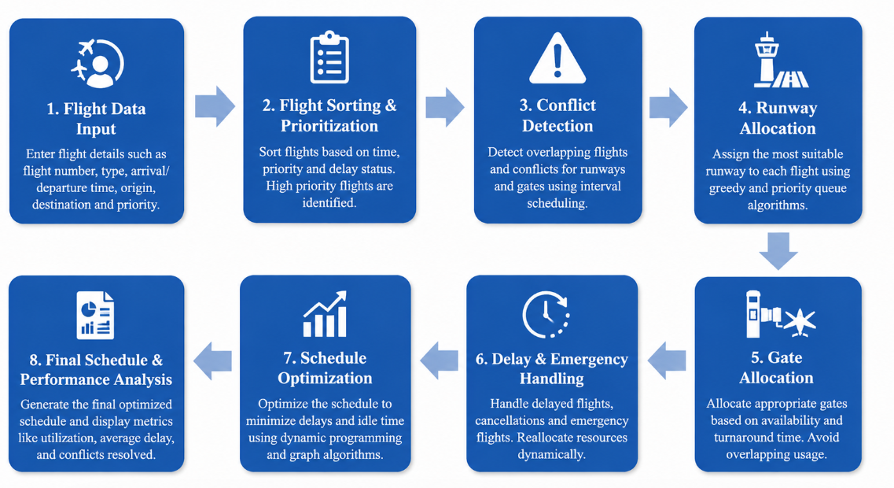
Workflow Diagram

Slide 6
Module 1 - ✈️ Flight Scheduling & Conflict Detection

Slide 7
Core Functionality
Collect and manage arrival and departure flight details.
Sort flights based on scheduled time, priority, and flight type.
Assign scheduling priorities to emergency, delayed, and regular flights.
Detect overlapping flight schedules and potential conflicts.
Identify conflicts caused by limited runway and gate availability.
Use Interval Scheduling to manage flights within available time slots.
Use Priority Queue to process high-priority flights efficiently.
Generate an initial conflict-free flight schedule for resource allocation.

Slide 8
Module 2 - 🛫 Runway & Gate Resource Allocation

Slide 9
Core Functionality
Maintain the availability status of airport runways and gates.
Assign the most suitable runway to each arrival or departure.
Allocate gates based on flight timing and resource availability.
Prevent simultaneous allocation of the same runway or gate.
Use a Greedy Algorithm to make efficient resource assignments.
Use Min Heap/Priority Queue to identify resources becoming available earliest.
Reallocate runways and gates when flight delays or cancellations occur.
Improve overall runway and gate utilization while minimizing idle time.

Slide 10
Module 3 - Intelligent Optimization & Performance Analytics

Slide 11
Core Functionality
Analyze the generated schedule for remaining conflicts and delays.
Optimize the sequence of flights to minimize overall waiting time.
Reduce unnecessary runway and gate idle time.
Handle emergency and high-priority flights without disrupting the entire schedule.
Use Dynamic Programming to evaluate alternative scheduling combinations.
Apply Graph-based techniques to represent flight conflicts and dependencies.
Compare different algorithms based on execution time and scheduling efficiency.
Generate performance metrics such as average delay, resource utilization, conflicts resolved, and optimization score.

Slide 12
Conclusion
The proposed system provides an automated approach to airport flight scheduling.
It efficiently manages flights, runways, and gates using algorithmic techniques.
Conflict detection and intelligent resource allocation help reduce scheduling problems.
Optimization techniques can improve airport resource utilization and minimize delays.
The system demonstrates the practical application of DAA concepts to a real-world problem.

Slide 13
THANK YOU

